Slide 2
Chapter 5
Cloud Data Center

Slide 3
Learning Outcomes
At the end of the session you will be able to:
Comprehend the core elements of cloud data center
Describe the different storage options
Describe RAID technology and its advantages
Understand database and its management
Understand the various technologies of backup and recovery
Discuss replication technologies
Describe life cycle management
Describe cloud analytics
Understand traditional data center management

Slide 4
Cloud Data Center Core Elements
The important cloud elements are as follows:
1. Clients (i.e., mobile, thin, or thick)
2. Data center (i.e., collection of servers, IT, and non-IT equipment)
3. Distributed servers (geographically distributed)
4. Storage

Slide 5
Cloud Data Center Core Elements
The principal components of a cloud data center (CDC) comprise:
Application: It is a computer program which has the ability of computing operations. Applications can use a DBMS that uses operating system services in order to work on, retrieve, and store functions on storage tools.
2. DBMS: It offers planned means to save data in rationally prepared tables which are unified. DBMS optimizes the retrieval and storage of data.
3. Compute: It is a physical computing machine which controls applications, databases, and operating systems.

Slide 6
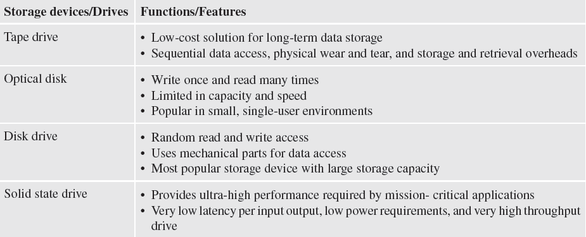
Cloud Data Center Core Elements
4. Storage: It refers to a tool which constantly saves data for subsequent use. The distinct necessities of storage are dependent on the sum of data to be saved and for the period it is to be saved.
5. Network: It is a connecting path which allows communication among compute systems and customers or among storage and compute systems.

Slide 7
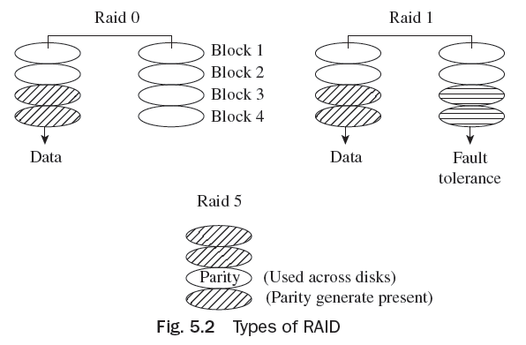
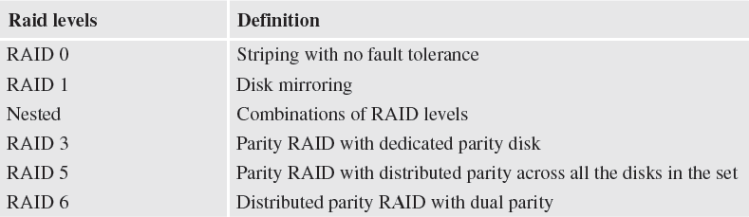
Types of RAID and Definition of various RAID levels
(Redundant Arrays of Independent Disks)

Slide 8
Components of Fibre Channel SAN
The following are the components of a Fibre Channel SAN:
• Node ports
• Cables
• Connectors
• Interconnecting devices
• Storage arrays
• SAN management software

Slide 9
Object-based Storage Technologies
Object-based storage merges data with rich metadata in order to create an ‘object’.
Object-based storage saves data in a flat address space.
Every object in object storage is recognized through a distinctive ID known as object ID.
Simple object access protocol (SOAP) is a means of switching messages between associates on a disseminated network, like the Internet. SOAP offers an array of XML aspects and components that are utilized to build a ‘SOAP’ message.
Object-based storage has an even address space that fulfils the want for controlling RAID and LUN groups.
Rather than RAID systems used for backup strengthening, storage managers can force object-based storage to simply generate multiple copies, as required, with every copy recognized with a similar object storage ID.

Slide 10
Unified Storage
Unified storage merges SAN-based, object-based, and NAS-based access inside a single amalgamated platform.
It supports NAS protocols (i.e., NFS for UNIX or Linux and CIFS for Windows) fibre channel, iSCSI, REST, SOAP, and FCoE protocols.
The capability to assist multiple protocols from a similar storage system aids to liberally merge and counterpart workloads to really enhance consumption.
Possessing a one-data model and toolset for amalgamated storage facilitates a reliable administration structure athwart various workloads and applications.
Amalgamated storage has been offered by storage consolidation.

Slide 11
Business Continuity
Business continuity (BC) is a significant procedure for classifying and executing.
BC involves arranging for, responding to, and improving from a system outage which unfavorably influences corporation functions.
It is a procedure of reinstating or recommencing corporation operations from a reliable replica of the data.
Hot site: It is a site where functions of businesses may be stimulated, in the event of a catastrophe.
Cold site It is a site where functions of businesses may be stimulated, in the event of a catastrophe.
Cluster A set of servers and other essential resources are united to function as a solo system.

Slide 12
Cloud Backup
Backup is a replica of the manufactured data, generated and maintained for the only intention of improving corrupted or deleted data.
Backup technologies, maintenance, and revival necessities for applications and data are a vital step to guarantee successful execution of the revival and backup solution.
Backups are carried out for three key reasons—documentation, operational restores, and disaster recovery.
Based on necessities, corporations use diverse backup approaches for catastrophe recovery. Data in the construction situation alters with each industry deal and function.
The backup replicas are used for reinstating data at an alternating location when the primary location is harmed because of a catastrophe.

Slide 13
Cloud Backup
The majority of corporations use an amalgamation of these three kinds of backup to meet the backup and recovery necessities.
The backup metadata has been obtained by the backup server from the backup consumers to carry out its actions.
The metadata is saved either locally inside the backup server or outwardly in a storage range.
The storage joint is accountable for writing data to the backup tool. Characteristically, the storage joint is incorporated through the backup server and both are hosted on a similar physical platform.

Slide 14
Cloud and Disaster Recovery
The backup server synchronizes the backup procedure with all the constituents in a backup arrangement.
The backup server recovers the backup-concerned information from the backup list and, on the basis of this information, initiates a suitable storage joint to put in the backup media into the backup tools.
The backup consumer transmits the data to the storage joint, and the storage joint inscribes the data to the storage tool.
The backup server recognizes the backup media needed for the reinstate and informs the storage joint to put in the backup media. Then, the data is interpreted and transmitted to the consumer which has been recognized to obtain the reinstated data.

Slide 15
Cloud and Disaster Recovery
Backing up disk storage systems proposes lucid benefits, owing to their essential random access and RAID security facilities.
Several types of backup permit for backup descriptions to remain on the disk for a period of time even after they have been staged.
As for backup software, both physical tape library and virtual tape library are the same. Virtual tape uses disks for backup. A virtual tape can span multiple LUNs, if required.
Virtual tape supports instantaneous support, which is distinct from physical tape library, and has mechanical delays.

Slide 16
Replication Technologies
The procedure of generating an accurate/similar replica of data is known as replication.
The main aim of replication is to allow users to have the chosen data at the correct place, in a condition suitable to the needs of revival.
Replicas may be used to address a number of business permanence performances, such as those given here:
1. Offering an alternating source for backup to enhance the effect on
construction
2. Offering a source for rapid revival

Slide 17
Replication Technologies
3. Facilitating judgment support actions, like reporting
4. Mounting and analysing projected modification to an application or an operating situation
5. Reviving an application from the copy in the occurrence of a malfunction in the source level
Replicas may be continuous or point-in-time (PIT).
• Continuous replica: The data on the replica is matched with the manufacture
data during the entire period.
• PIT: The data on the replica is a copied picture of the manufacture at a
certain timestamp.

Slide 18
Replication Technologies
For every business function, the replica may be accessed by an alternating
server.
Storage group-based regional replication may be classified as follows:
Pointer-based virtual replication
Pointer-based complete degree replication
Complete degree mirroring
Replication might be synchronous or asynchronous. SAN-based isolated replication permits the data replication among assorted dealer storage groups.
There is no effect on the manufacturer servers or the LAN as replication is made by the group and the data is moved over the SAN.

Slide 19
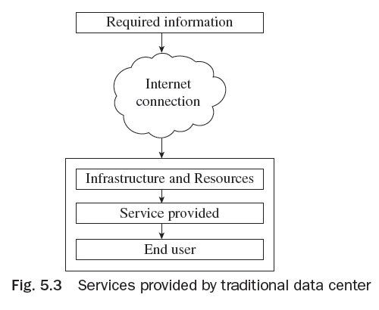
Traditional Data Center Management
The chief administration actions in a conventional or traditional data center are as follows:
1. Vigilance and scrutinizing
2. Reporting
3. Accessibility administration
4. Capability administration
5. Functioning administration
6. Safety administration

Slide 20
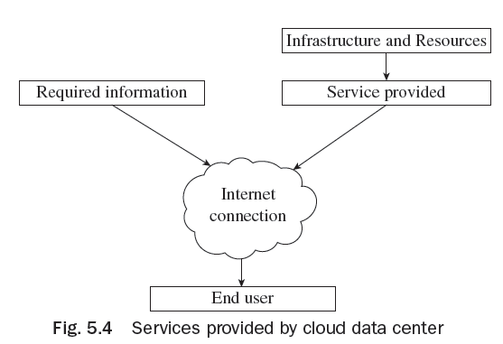
Services provided by Cloud Data Center

Slide 21
Information Life Cycle Management
Information life cycle management (ILM) is a procedure for organizing information via its life cycle, from beginning to its clearance. The key assessments required to be made as division of the ILM strategy for the business are as follows:
When is it important to record the business data from live or transactional databases to archived databases?
Up to what phase will the data be saved in the operational databases before they may be set out forever?

Slide 22
Information Life Cycle Management
The vital features are as follows:
1. Insignificant or surplus information slows application functioning and augments the time needed to advance applications and backup databases.
2. In-house features will principally be determined during negotiations, which refers to how valuable the information will be to the corporation in its business dealings.
3. Peripheral aspects will be principally directed by authorized and inflexible necessities; inparticular, the least sum of time information enclosed by that legislation must be reserved.

Slide 23
Information Life Cycle Management
An ILM policy must comprise the following features:
Business-centric
Centrally managed
Policy-based
Heterogeneous
Optimized
Tiered storage

Slide 24
Cloud Analytics
Cloud analytics is a sort of cloud service module where exploration of data and associated services are carried out on a private or public cloud.
Cloud analytics is chiefly a cloud-facilitated resolution which permits a corporation or person to work intelligence measures or business studies.
Cloud analytics is a service module wherein constituents of the data investigative procedure are offered via a private or public cloud.
Cloud analytics services and applications are characteristically proposed
underneath a contribution-based or utility (pay per use) costing model.

Slide 25
Cloud Analytics
Cloud-based social media analytics involves the isolated provisioning of devices which comprise applications for choosing social media sites which serve your intentions, divide applications for gathering data, data investigative software, and storage services.
Spending on cloud analytics may be rewarding for a corporation but appropriate preparation is necessary to make sure that all six investigative components are concealed.

Slide 26
Computing on Demand
On-demand computing (ODC) is a model of computing at enterprise level. In this technology, resources are offered on a pay-per-use basis.
ODC is recognized as utility computing or on-demand computing too.
The main benefit of ODC is its low basic price, since computational resources are substantially hired when they are needed.
On-request computing goods are swiftly becoming common in the market. HP, Microsoft, Computer Associates, Sun Microsystems, and IBM are among the more famous on-request sellers. These companies mention to their on-request services and goods by various names. IBM names it as ‘OnDemand Computing’.

Slide 27
Thank You!

